Slide 1
Circular Motion
Uniform circular Motion
Non-uniform circular motion

Slide 2
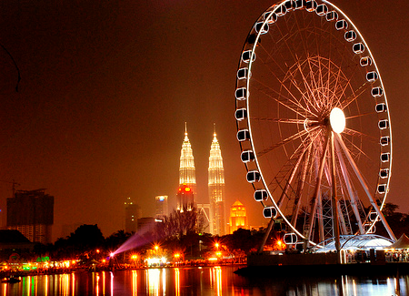
Uniform circular motion
Refers to the motion of an object in circular path at a constant speed.
Could be either having vertical or horizontal trajectory

Slide 3
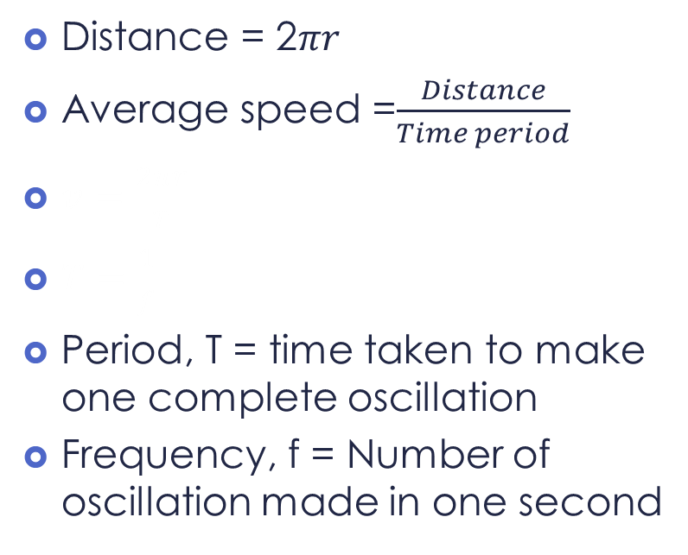
Uniform Circular Motion
v
Distance = 2$πr$
Average speed =$\frac{Distance}{Time period}$
$v=\frac{2πr}{T}$
$T=\frac{1}{f}$
Period, T = time taken to make one complete oscillation
Frequency, f = Number of oscillation made in one second
r

Slide 4
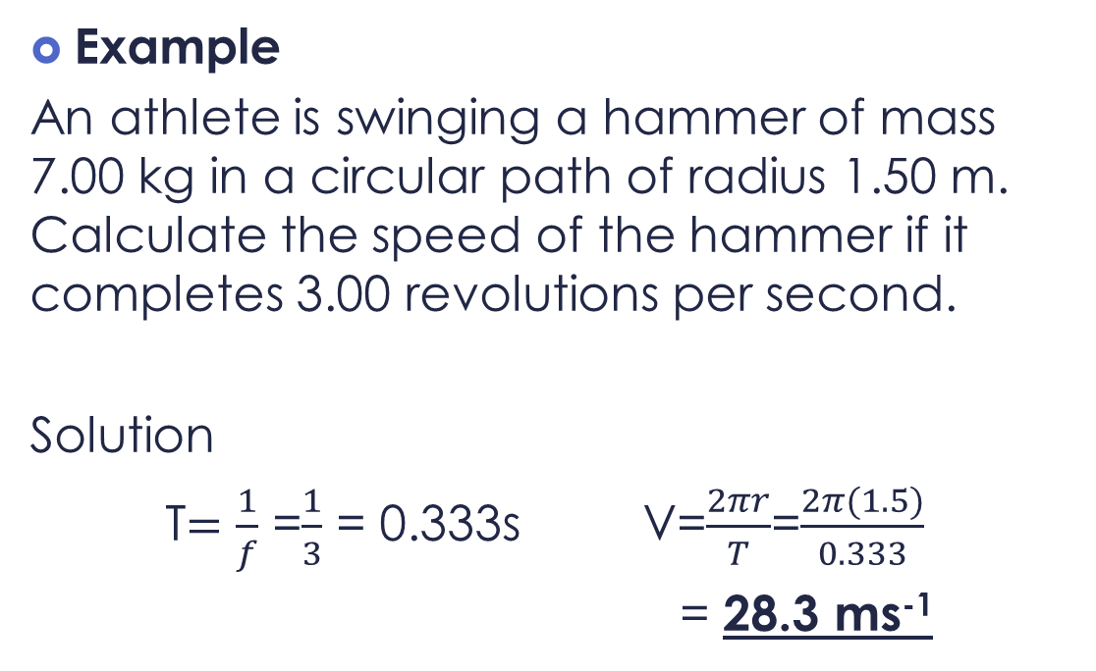
Uniform Circular Motion
Example
An athlete is swinging a hammer of mass 7.00 kg in a circular path of radius 1.50 m. Calculate the speed of the hammer if it completes 3.00 revolutions per second.
Solution
T$=\frac{1}{f}$ =$\frac{1}{3}$ = 0.333s V=$\frac{2πr}{T}$=$\frac{2π(1.5)}{0.333}$
= 28.3 ms⁻¹

Slide 5
Uniform Circular Motion
v
Speed is constant.
Velocity changes as direction changes.
Therefore the object is accelerating even though the speed is constant.
These acceleration is centered towards circle and called centripetal acceleration (a_{c})
a_{c}
v
a_{c}
a_{c}
v
a_{c}
v

Slide 6
Uniform Circular Motion
Centripetal acceleration
v₁
v₂

Slide 7
Uniform Circular Motion

Slide 8
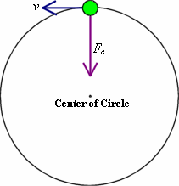
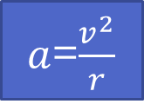



Uniform Circular Motion
Centripetal acceleration
since , $v=\frac{2πr}{T}$
Therefore , centripetal force , F_{c} is
$a$=$\frac{v^{2}}{r}$
$$a=\frac{4π2r}{T2}$$
F_{c}=ma=$\frac{mv2}{r}$=$\frac{4mπ2r}{T2}$

Slide 9
Uniform Circular Motion
Example
An athlete in a hammer throw event is swinging the ball of mass 7.00 kg in a horizontal circular path. Calculate the tension in the wire if the ball is:
a) moving at 20.0 m s^{–1} in a circle of radius
1.60 m
b) moving at 25.0 m s^{–1} in a circle of radius
1.20 m.

Slide 10
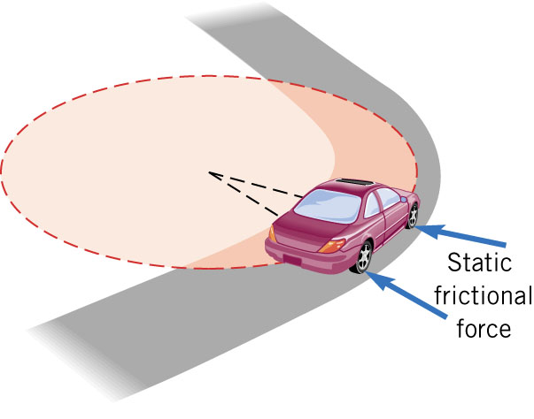
Uniform circular motion
An unbanked curve
N
horizontal friction force that the road exerts on the car's tires
f
mg
If there is no friction / less friction between the car and road, the car could not turn
Eg: ice covered road / F1 race
Vertical force (Fnet = 0)
Horizontal Force = f
f = Fc(centripetal force)

Slide 11
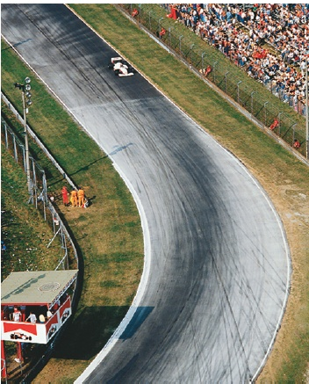
Uniform circular motion
Unbanked Curve
If the frictional force is insufficient, the car will tend to move more nearly in a straight line, as the skid marks show.

Slide 12
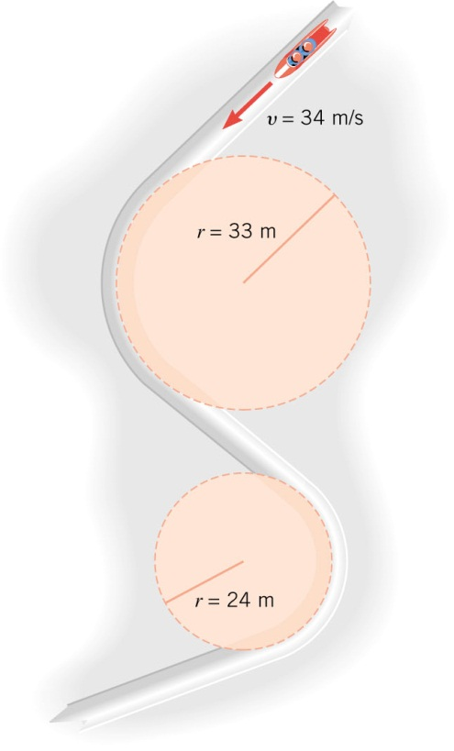
Uniform circular motion
Test yourself…
A car travels at a constant speed around two curves. Where is the car most likely to skid? Why?
Smaller radius: larger force required to keep it in uniform circular motion.

Slide 13
Uniform circular motion
Test yourself
A merry-go-round has an outer diameter of 9.0m.A small girl of mass 20kg rides on a horse 4.0 m form the center. The merry - go – round makes 3.6 revolutions per minute.
a)What is the speed of the girl
b)What is the speed of a point on the outer
edge of the merry- go – round?
c)What is the net force on the girl

Slide 14
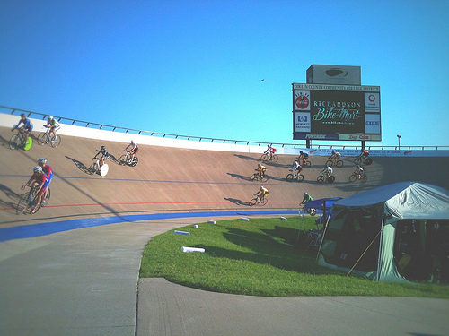
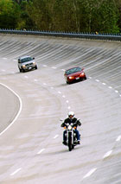
Uniform circular motion
Banked curve
Why exit in highways is banked?
To increase the centripetal force to increase the exit speed

Slide 15
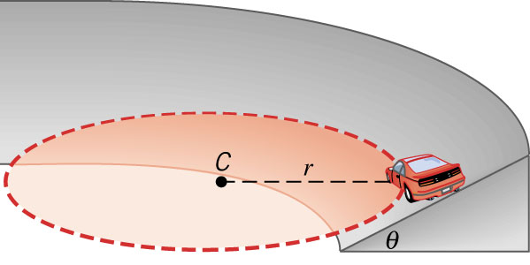
Uniform circular motion
Engineers have learned to “bank” curves so that cars can safely travel around the curve without relying on friction at all to supply the centripetal acceleration.
How much forces are
acting on the car (assuming
no friction)?

Slide 16





Uniform circular motion
Banked curves
F_{N}cos$θ$
F_{N}
Vertical Force
F_{N}cos$θ$ = mg
$$θ$$
F_{N}sin$θ$
Horizontal force =Centripetal force
F_{c}= F_{N}sin$θ$ =$\frac{mv^{2}}{r}$
mg
θ

Slide 17
Uniform circular motion
Test yourself
The Daytona 500 is the major event of the NASCAR season. It is held at the Daytona International Speedway in Daytona, Florida.
The turns in this oval track have a maximum radius(at the top) of 316m and are banked steeply, at an angle of 31⁰.Suppose the turn were frictionless, at what speed would the race car have to travel around them

Slide 18
Non-uniform circular motion
The speed of the object is not constant
The NET acceleration is no more pointed toward the center of circle
Two component of acceleration exist
a)Centripetal/radial acceleration – due to change
in direction of velocity
b)Tangential – due to change in magnitude of the
velocity

Slide 19
Non uniform circular motion
Tangential acceleration
Radial acceleration
center
NET ACCELERATION
Speed is changing

Slide 20


Non uniform circular motion
Ride at the top of roller coaster
$$Fc=\frac{mv^{2}}{r}=W+N$$
$N=\frac{mv^{2}}{r}−mg$
N
W
N
Ride at the bottom of roller coaster
$$Fc=\frac{mv^{2}}{r}=N−W$$
$N=\frac{mv^{2}}{r}+mg$
W

Slide 21


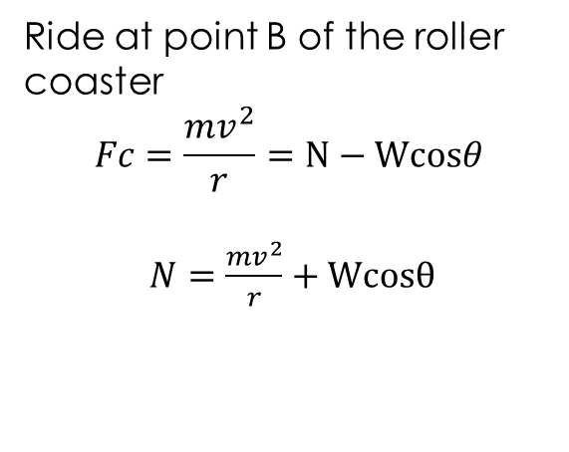

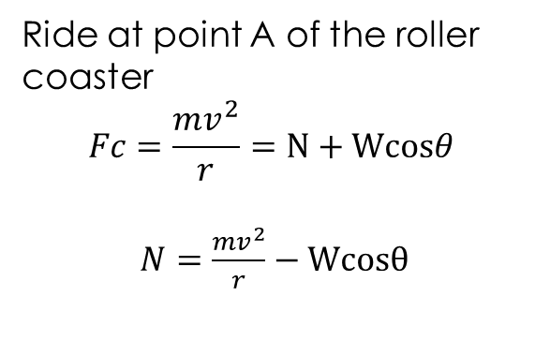

Non uniform circular motion
Ride at point A of the roller coaster
$$Fc=\frac{mv^{2}}{r}=N+Wcosθ$$
$N=\frac{mv^{2}}{r}−Wcosθ$
A
N
$$θ$$
Wcos$θ$
W
N
Ride at point B of the roller coaster
$$Fc=\frac{mv^{2}}{r}=N−Wcosθ$$
$N=\frac{mv^{2}}{r}+Wcosθ$
B
$$θ$$
Wcos$θ$
W

Slide 22
Non uniform circular motion
A pilot flies his plane in a vertical loop of radius 500m at such a speed that at the top of the loop he feels no force from either the seat or the seat belt
a)At what speed is the plane then flying
b)If his speed rises to 100ms-1 by the time he reaches the bottom of the loop, what force does he experience from the seat? Take his mass as 67kg

Slide 23
Non uniform circular motion
A student arranges a toy car track with a vertical loop of radius 0.200 m, as shown. A car of mass 150 g is released from a height of 1.00 m at point X. The car rolls down the track and travels around the loop. Assuming g is 9.80 ms⁻², and ignoring friction, calculate:
a) The speed of the car as it reaches the bottom of the loop, point
Y.[4.43 ms⁻¹]
b) The centripetal acceleration of the car at point Y. [98.0 ms⁻²]
c) The normal reaction force from the track at point Y. [16.2 N]
d) The speed of the car as it reaches the top of the loop at point Z.
[3.43 ms⁻¹]
e) The normal force from the track at point Z. [7.35 N]
f) The release height from which the car will just maintain contact
with the track as it travels past point Z. [0.5 m]

